Slide 1


Borcelle
March 24, 2036
Innovative & Collaborative
Annual
Report
It is about putting effort
and ideas into action.
Even throughout economic downturns, our
company has grown financially through
innovation, adaptation, and excellence.

Slide 2




Borcelle
March 24, 2036
Innovative & Collaborative
Content
Index
01
02
03
04
Company
Information
Business
Model
Company
Network
Financial
Position
05
06
07
Assets
Financial
Highlights
Stock
Highlights

Slide 3



Borcelle
March 24, 2036
Innovative & Collaborative
Board of
Commissioners’
Report
Dear Respected Stakeholders, Over the past year, the world has had to encounter the COVID-19
pandemic, which triggered a global health crisis and consequently adversely impacted the
global economic growth.
Borcelle is mindful that the pandemic has affected every aspect of our lives. Our top
priority is the safety and health of employees, and the company implemented a series of health
protocols in line with government recommendations. During these challenging times, we remain
committed to providing quality products and services to our customers.
Rufus Stewart
Ceo - Borcelle

Slide 4

Borcelle
March 24, 2036
Innovative & Collaborative
Company
Information
Date of Incorporation:
December 23, 1990
Business:
Share Listing:
Technology services:
internet of things,
artificial intelligence,
and blockchain.
The company’s stock
has been listed on the
stock exchange since
April 24, 1995.
Authorized Capital:
Paid-Up Capital:
4 million USD consisting
of 60,000,000,000 shares
with a nominal value of 1
USD per share.
3 million USD consisting
of 40,483,553,140 shares
with a nominal value of
0.51 USD per share.

Slide 5





Borcelle
March 24, 2036
Innovative & Collaborative
Company Strategy
and Strategic Policy
In order to enhance business continuity and strategies in the future, the Board of Directors has
reaffirmed Borcelle Pride of the Global as Goal 2030. With the scope of Borcelle's businesses and
operations across multiple continents, this makes sense; Borcelle aims to be "one of the best
managed corporations on the continent.". We must also transform Borcelle into an intelligent and
agile corporation in order to achieve sustainable growth.
Accelerate Digital
Transformation
Nurture Innovation
Culture
Gain Optimal Impact in
Public Contribution

Slide 6
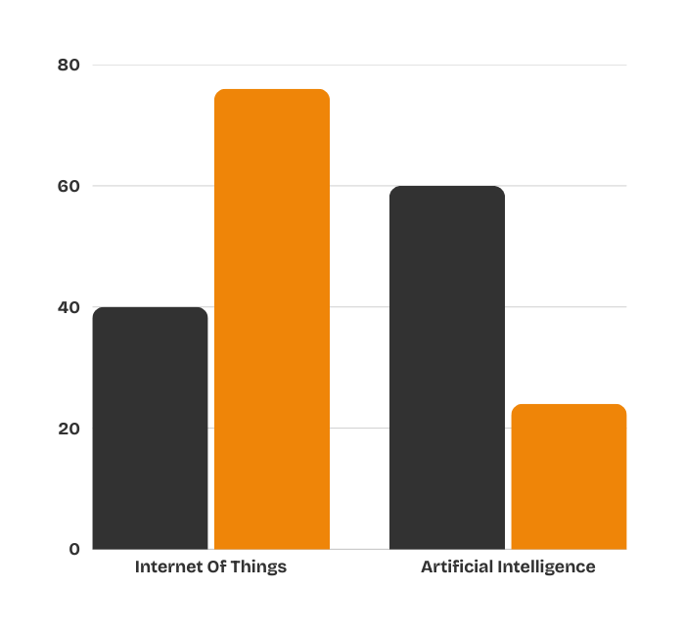



Borcelle
March 24, 2036
Innovative & Collaborative
Business
Model
Ratio
7 : 2
Describe how to monetize, who your customers are, distribution
channels, or fee structure. To determine how this business will
survive with your product or service and how your company will
make money and achieve its goals.
Yearly Developing
67% - 82%

Slide 7




Borcelle
March 24, 2036
Innovative & Collaborative
Company Network
The focus of the company on digitalization has been to move
the company forward with its business in the past few years.
23
78
Branches
Service Points

Slide 8
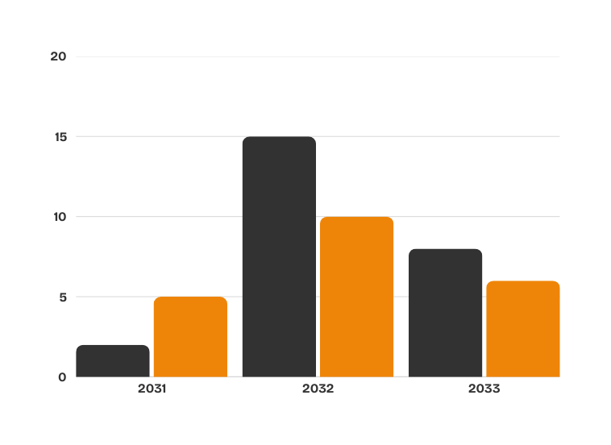

Borcelle
March 24, 2036
Innovative & Collaborative
Consolidated
Statements of
Financial Position
During 2031, current assets increased 3% from 1.9 million USD in 2020
to 2.1 million USD. The increase was mainly due to a 95% increase in
cash and cash equivalents to 4.5 million USD.
In 2032, non-current assets decreased 4% from 24 million USD in
2019. This was mainly due to a 27% decrease in investments in joint
ventures and associates to 8 million USD.

Slide 9

Borcelle
March 24, 2036
Innovative & Collaborative
Assets
Consolidated Statement
of Financial Position
(Million USD)
As at 31 December
Change
2030
2031
USD
%
Current Assets
The focus of the company on digitalization has been to move
the company forward with its business in the past few years.
Cash & Cash Equivalents
$ 324
$ 281
$ 800
42%
Trade Receivables - net
$ 487
$ 322
$ 332
16%
Financing Receivables - net
$ 541
$ 343
$ 276
8%
Inventories
$ 221
$ 193
$ 175
3%
Other Current Assets
$ 187
$ 194
$ 207
2%
Total Current Assets
$ 1,760
$ 1,332
$ 1,790
72%

Slide 10


Borcelle
March 24, 2036
Innovative & Collaborative
Assets
Consolidated Statement
ofFinancial Position
(Million USD)
As at 31 December
Change
2030
2031
USD
%
Non-current Assets
Trade Receivables - net
$ 321
$ 311
$ 807
42%
Financing Receivables - net
$ 645
$ 322
$ 212
16%
Inventories
$ 231
$ 341
$ 221
8%
Investments in Joint Ventures
& Associates
$ 423
$ 195
$ 227
3%
Investment Properties
$ 1,071
$ 1,332
$ 1,790
2%
Goodwill and Other Intangible Assets
$ 1,706
$ 1,233
$ 1,771
72%
Fixed Assets - net
$ 1,445
$ 1,145
$ 1,371
14%
Concession Rights - net
$ 1,332
$ 1,089
$ 1,070
21%
Total Non-current Assets
$ 1,899
$ 1,330
$ 1,097
31%

Slide 11
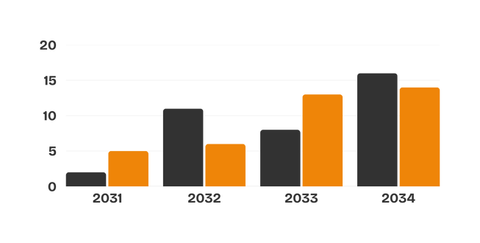
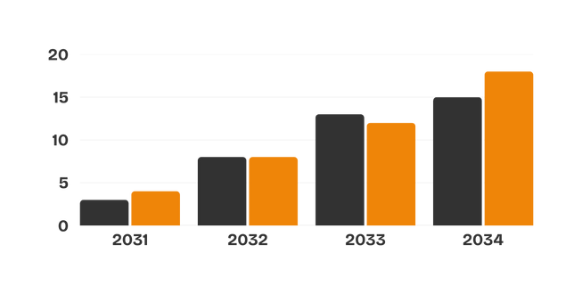

Borcelle
March 24, 2036
Innovative & Collaborative
Financial
Highlights
Net Revenue
By using cutting-edge innovations, our technological giant increased
revenue by leaps and bounds. The yearly report showed a strong
performance, with net profits rising significantly, confirming our
dedication to technological innovation and digital financial success.
Profit Attributable

Slide 12
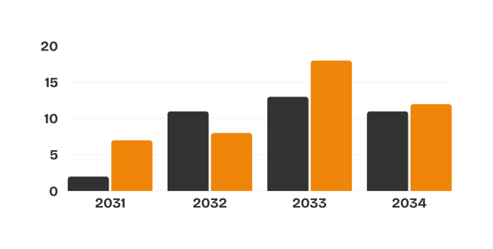


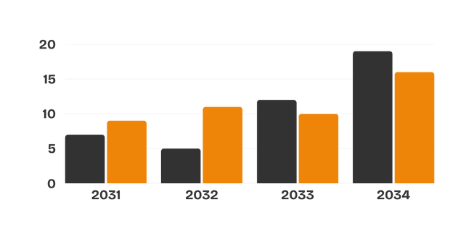
Borcelle
March 24, 2036
Innovative & Collaborative
Financial Highlights
Net Revenue
Profit Attributable

Slide 13

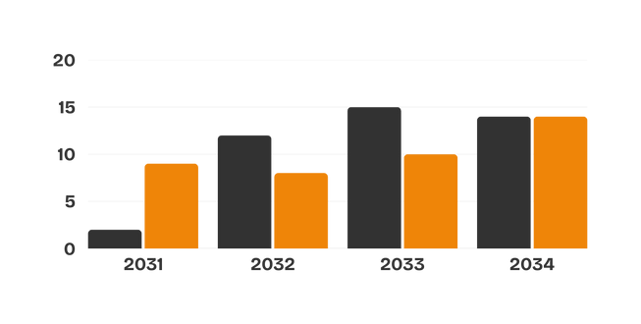
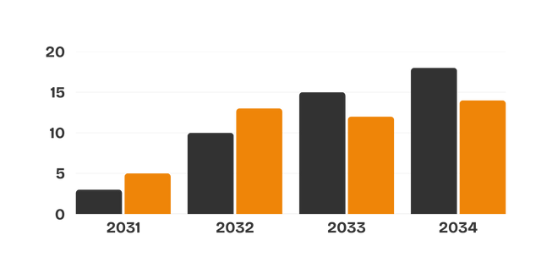

Borcelle
March 24, 2036
Innovative & Collaborative
Financial Highlights
Net Revenue
Profit Attributable

Slide 14
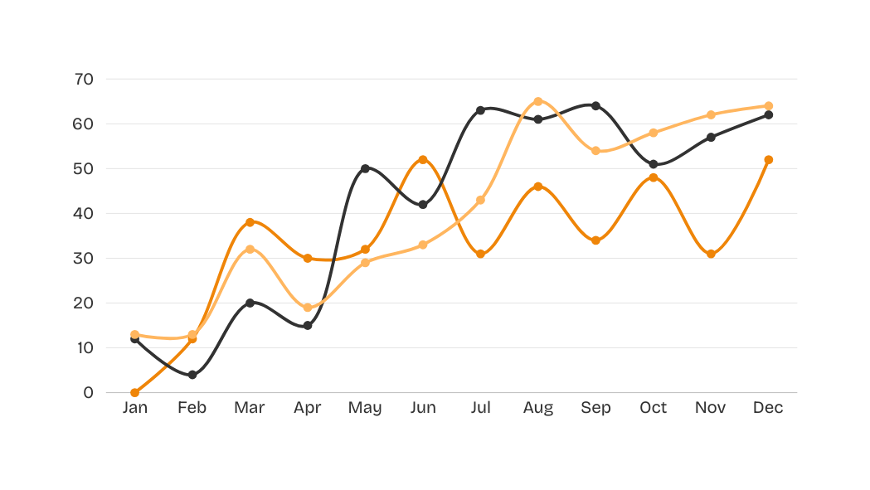

Borcelle
March 24, 2036
Innovative & Collaborative
Stock Highlights
Despite market volatility, the company outperformed important
indices due to excellent profitability, strategic acquisitions, and
positive economic indicators.
73%
68%
78%
Company Growth
Stock Growth
Financial Growth

Slide 15


Borcelle
March 24, 2036
Innovative & Collaborative
2030-2031
Lowest Price
Highest Price
Closing Price
Average Daily Trading
Volume (shares)
Period
2030
2031
2030
2031
2030
2031
2030
2031
Quarterly Company Stock Price
and Trading Volume
Quarter 1
$ 2,890
$ 2,894
$ 3,090
$ 3,207
$ 2,957
$ 2,781
$ 19,657
$ 19,110
Quarter 2
$ 2,760
$ 2,414
$ 3,118
$ 3,281
$ 2,335
$ 2,433
$ 17,104
$ 18,402
Quarter 3
$ 2,891
$ 2,897
$ 3,211
$ 3,198
$ 2,980
$ 2,801
$ 15,677
$ 19,221
Quarter 4
$ 2,765
$ 2,324
$ 3,218
$ 3,040
$ 2,150
$ 2,440
$ 19,124
$ 16,340
+25%
Company Value

Slide 16



Borcelle
March 24, 2036
Innovative & Collaborative
Thank
You
Write down your hopes for the future of your company.
Don't forget to thank the company for the opportunity
and convince related parties to support your company.
123 Anywhere St., Any City, ST 12345
www.reallygreatsite.com
+123-456-7890

